Slide 1
Welcome to the Drager/Ross Team!

Slide 2
Morning Routine
Students arrive, unpack
Arrival to the classroom by 7:30 is very helpful
Announcements start at 7:45 and Math/LA starts promptly after Morning Meeting

Slide 3
EveryDay Binder
Will be taken home daily
Please sign agenda each night after reviewing homework
Only homework/notes home should be in the front pocket

Slide 4
Math
Main units of focus this year
will be:
Multiplication/division
Area/perimeter
Fractions
Each unit of study varies in length.
Students are given a pretest to gauge level of knowledge and then provided differentiated instruction

Slide 5
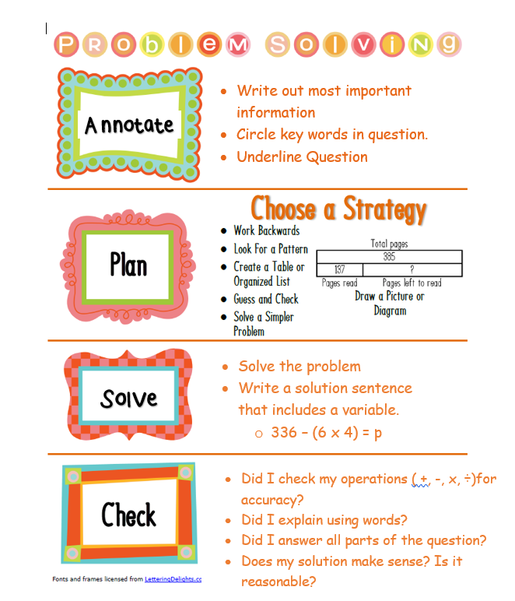
Problem Solving is in every unit.
Students will be asked to solve problems using the 4 steps below.
Mrs. Drager has 3 bags of pumpkin spice donuts. There are 4 donuts in each bag. How many donuts does Mrs. Drager have??
3 bags of donuts.
4donuts = each bag.
3 groups of 4 = 4 + 4 + 4 = 12
4 + 4 = 8 + another 4 = 12. This makes sense.

Slide 6
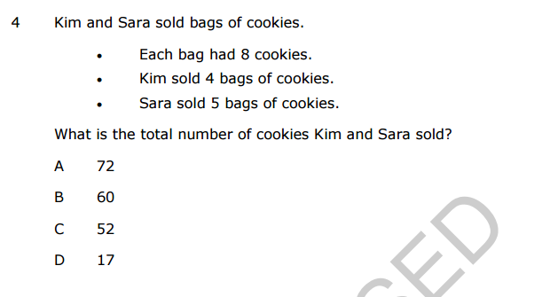
EOG – Math Question Example
Many word problems will be two step on the EOG.

Slide 7
Reading/Writing Modules
One Module with three units per quarter
Reading and Writing instruction/practice is integrated
Quarter 1: Overcoming Learning Challenges
Quarter 2: Frogs
Quarter 3: Literary Classics - Peter Pan
Quarter 4: Water Conservation

Slide 8
EOG - Sample Reading

Slide 9
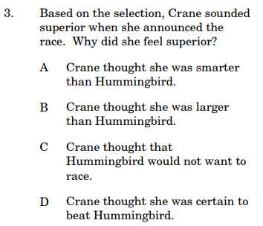
EOG - ELA Question

Slide 10
Science & Social Studies
Science themes include human body, plants, soil, changes, and objects in the sky.
Social Studies themes include civics and government, history, economics, and maps and globes.

Slide 11
Behavior in our Classroom
Self control
Winning Attitude
Integrity
Maintain Safety
Focus on Positive behavior
Earn Tickets
Star Student of the Week

Slide 12
Homework
Homework written daily in agendas
Also written on teacher website
Math/LA homework sent Mon-Thurs
Daily reading (record on Reading Log)
Reinforces skills taught in class
50 minutes each night per WCPSS guideline

Slide 13
Communication
Email: ldrager@wcpss.net
jeross@wcpss.net
Twitter: @MrsDragerTweets
SeeSaw
REMIND app
Homework Agenda
Friday Folders/Conduct Sheets (please sign and return tests and keep all of the other papers☺)
Notes:
Open and honest communication fosters a partnership in children’s learningOpen and honest communication fosters a partnership in children’s learning

Slide 14
Resources and LInKS

Slide 15
Thank you for reading!
We are looking forward to a great year and working together to provide your child with the best and most successful learning experience.
Please email us any questions you may have about our classrooms.
Mrs. Drager & Mrs. Ross

